Slide 1

Predictive Modelling
For COVID-19 in public health
Faith Isobo
FE/23/67501522

Slide 2
Methodology
Project road map
Data Preparation
Feature Engineering
Exploratory Data Analysis (EDA)
Data cleaning and transformation for better model accuracy.
.
Performed Feature engineering for model better performance, the future engineering was done by generating new features and performing feature selection
conducted exploratory data analysis to uncover key metrics in the datasets .
Model Development
In this project two models were developed Times series mode and classification model.

Slide 3

Feature Engineering
Generated features like population per 100,000, daily growth rates and mortality rate.
Selected features using correlation methods and feature importance.

Slide 4
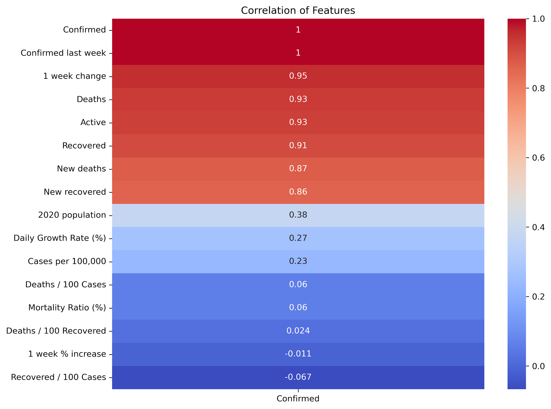
Features selection using correlation
.

Slide 5
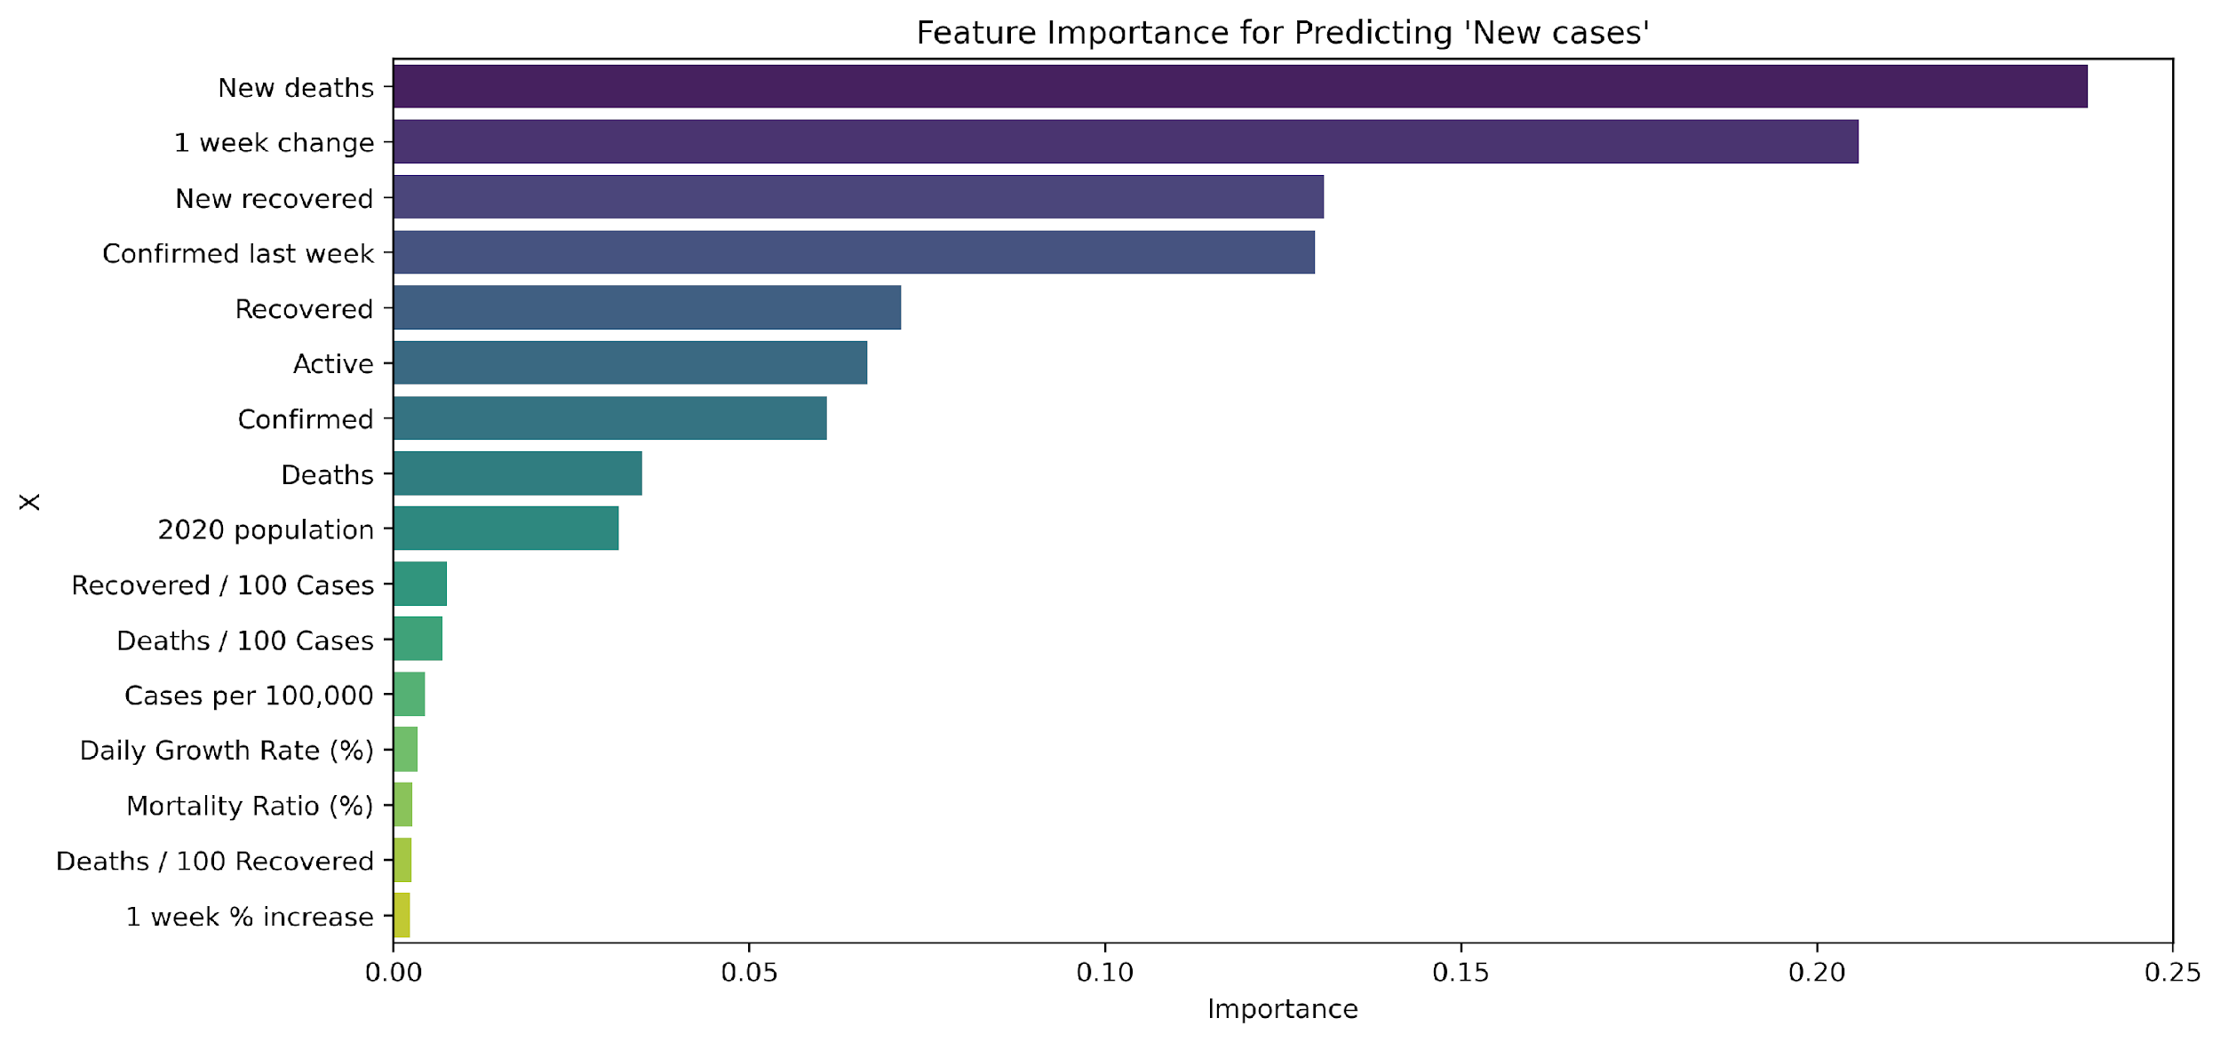
Features selection using feature importance.
.

Slide 6
Exploratory Data Analysis (EDA)
The EDA uncovered top insights such as the following:
USA has the highest number of confirmed cases.
The Distribution of Daily Growth Rate of covid-19 confirmed cases lies between 0 and 10000.
The highest distribution of cases per 100,000 of a country’s population is 100 cases to 100,000 population.
The highest distribution of Mortality Ratio % is 1% of each confirmed cases with a high frequency of over 40.
The country with the least confirmed cases is Fiji.

Slide 7
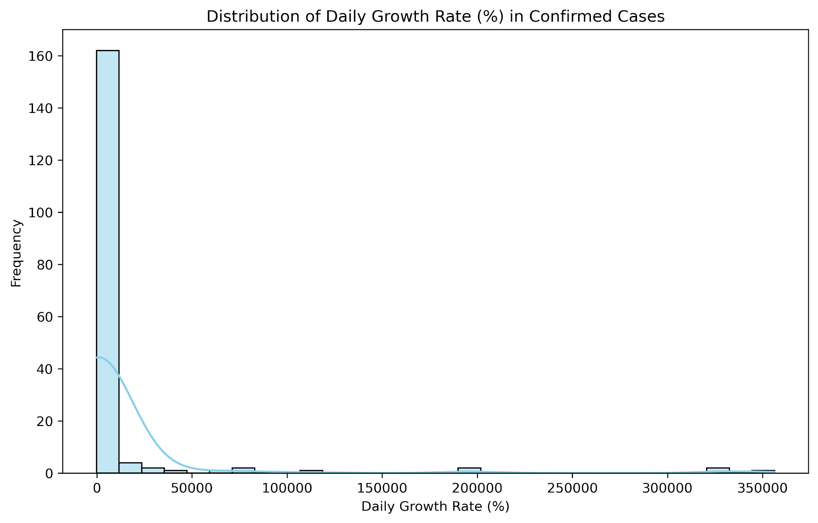
.

Slide 8
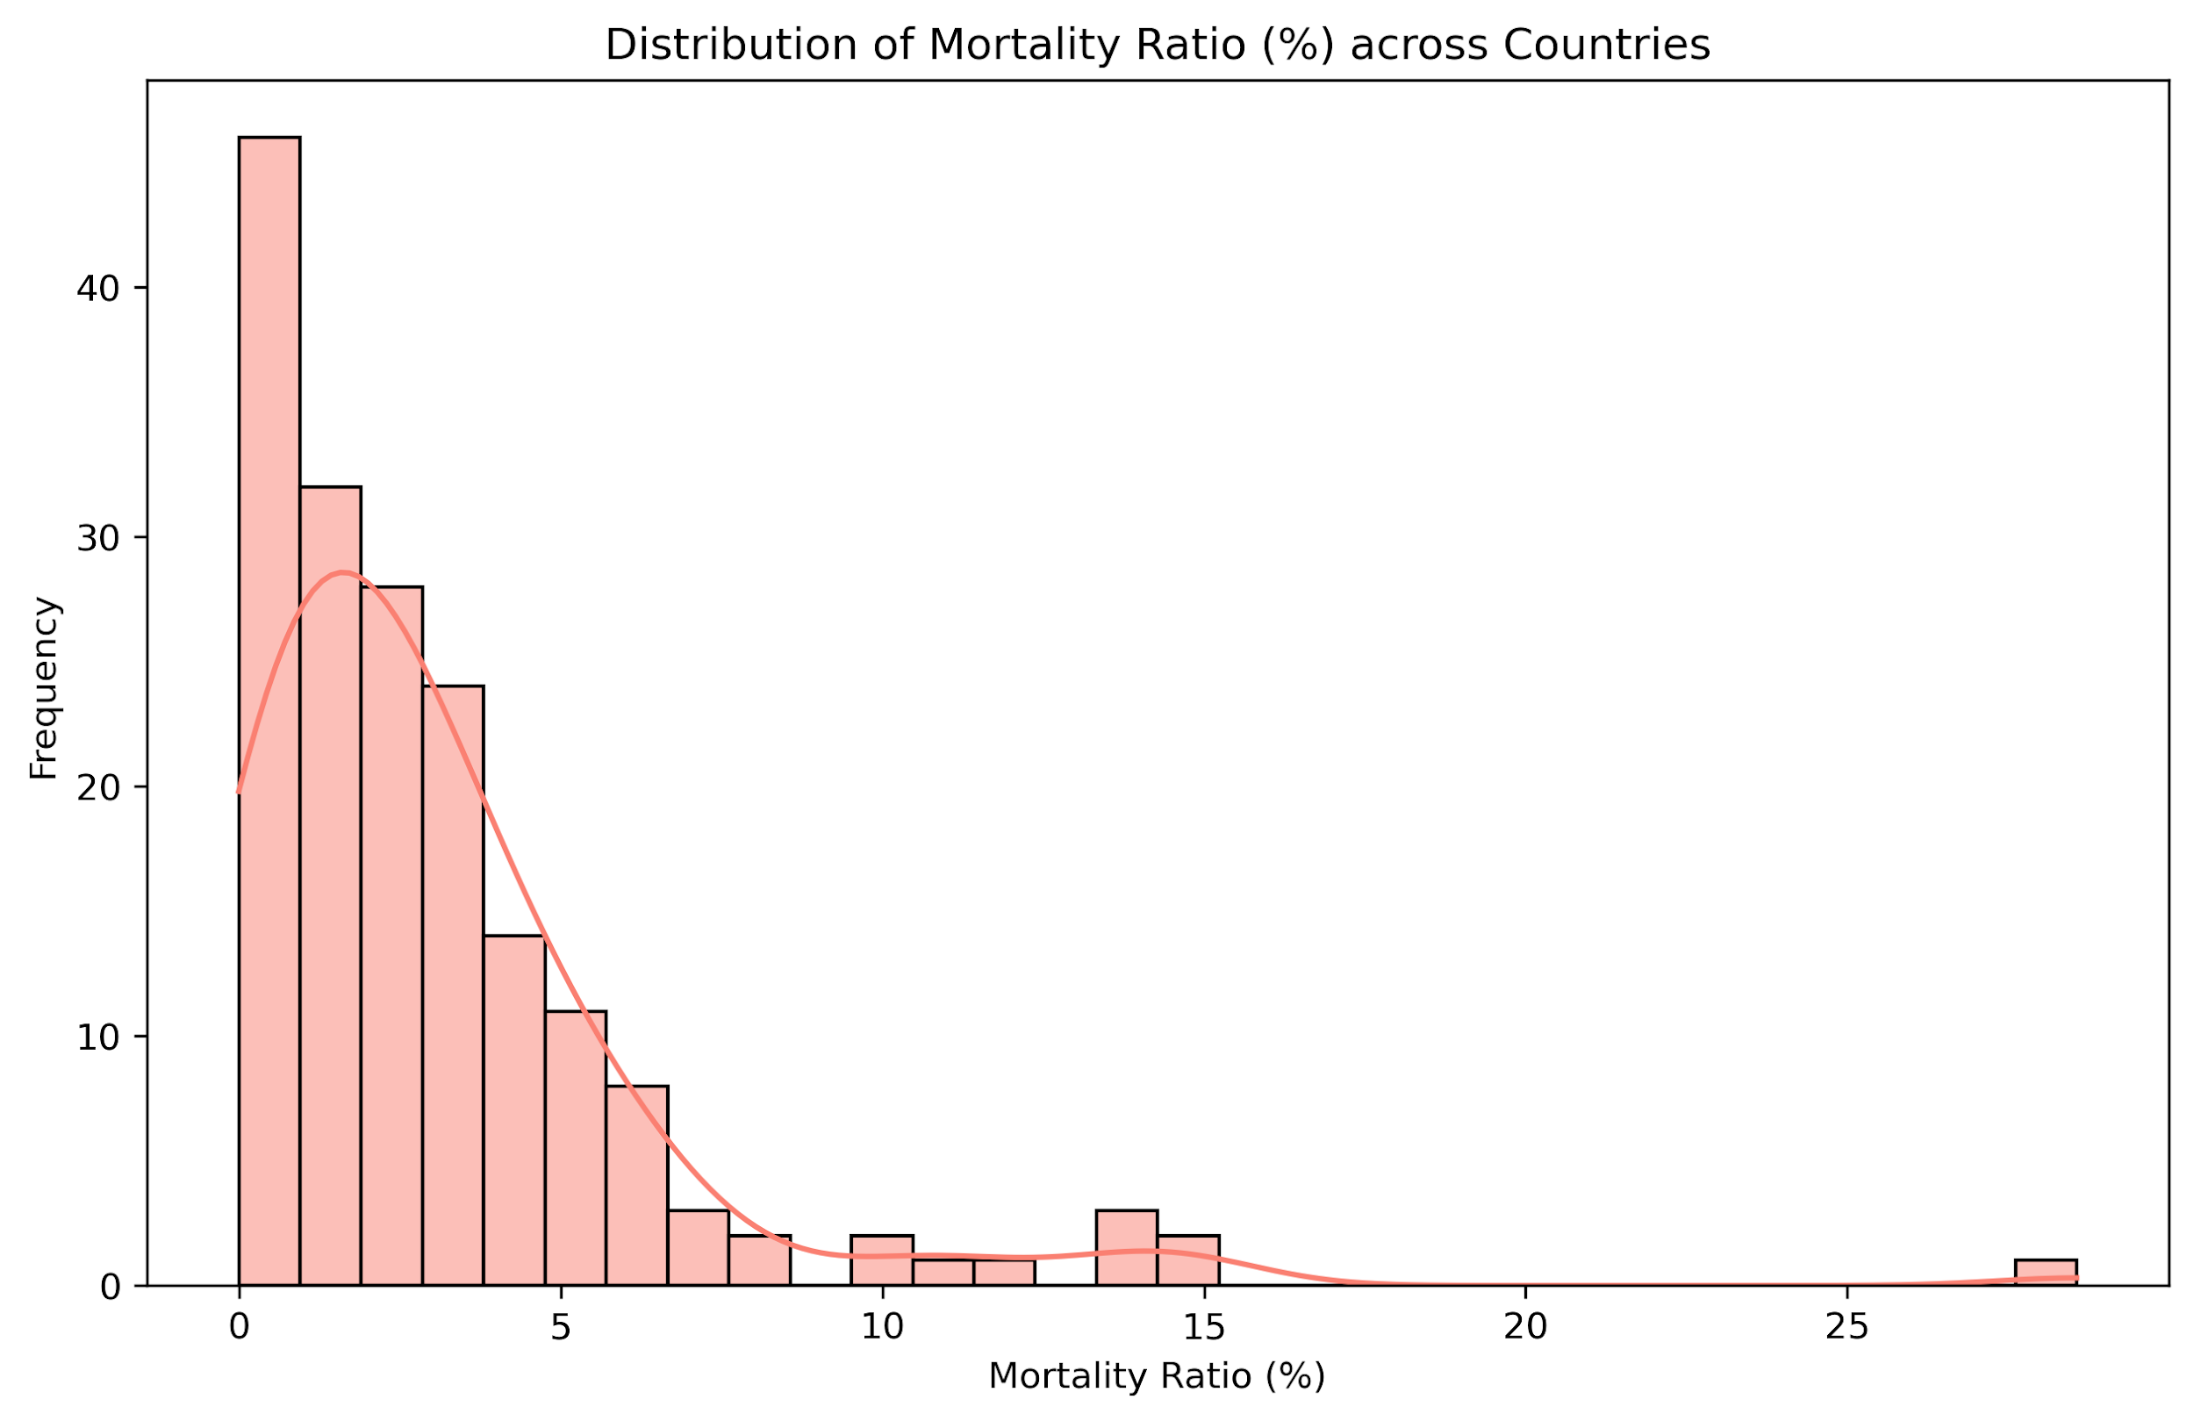
.

Slide 9
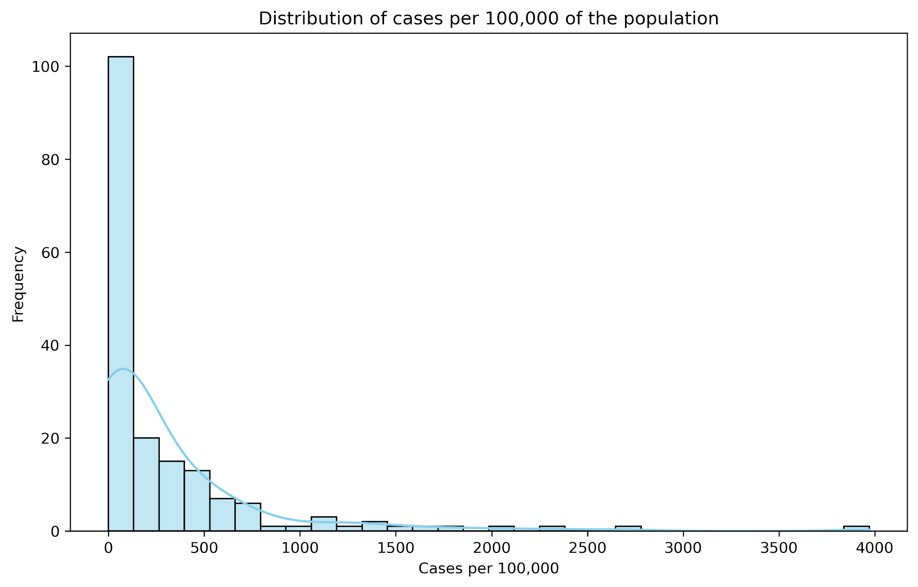
.

Slide 10
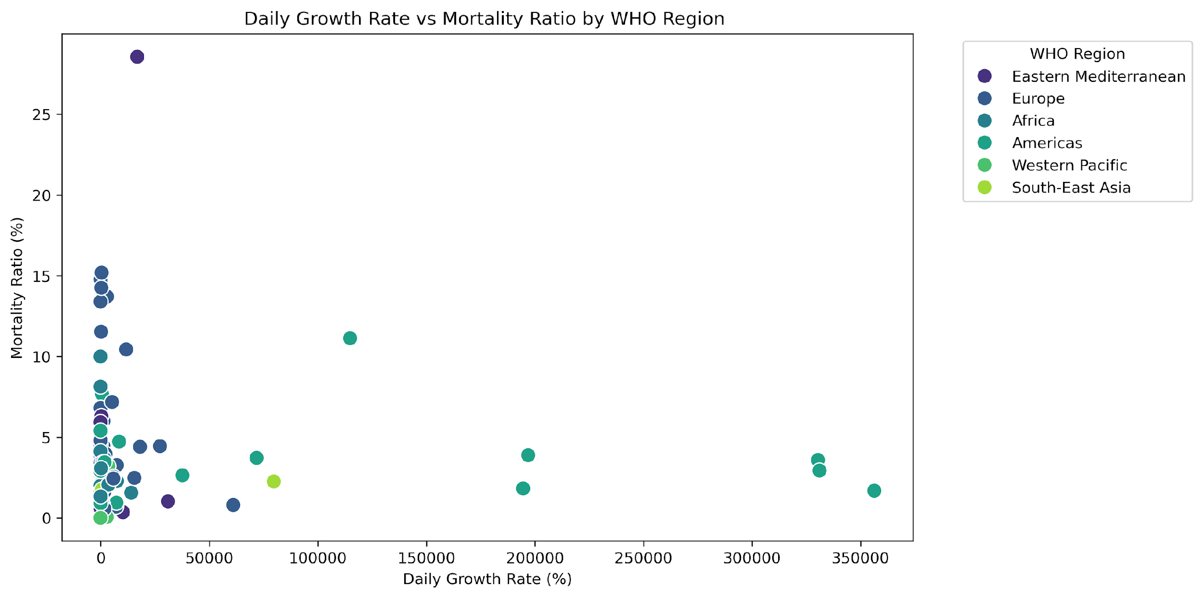
.

Slide 11
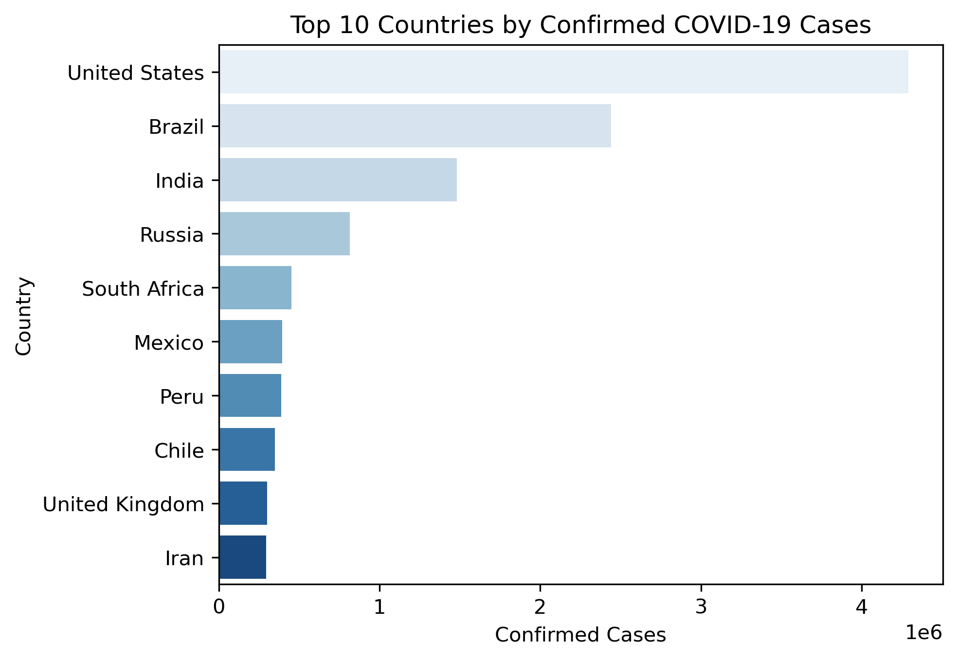
.

Slide 12
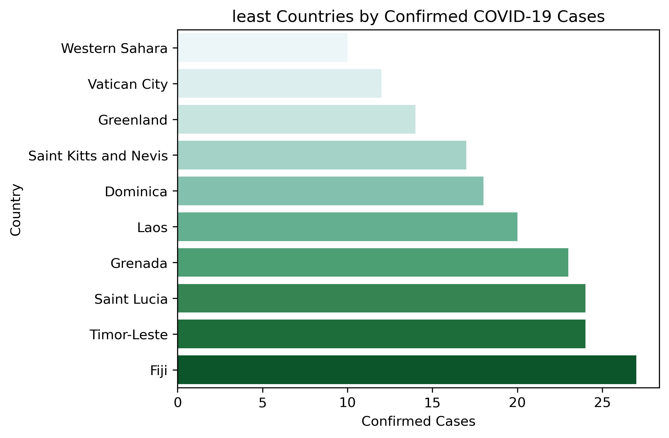
.

Slide 13
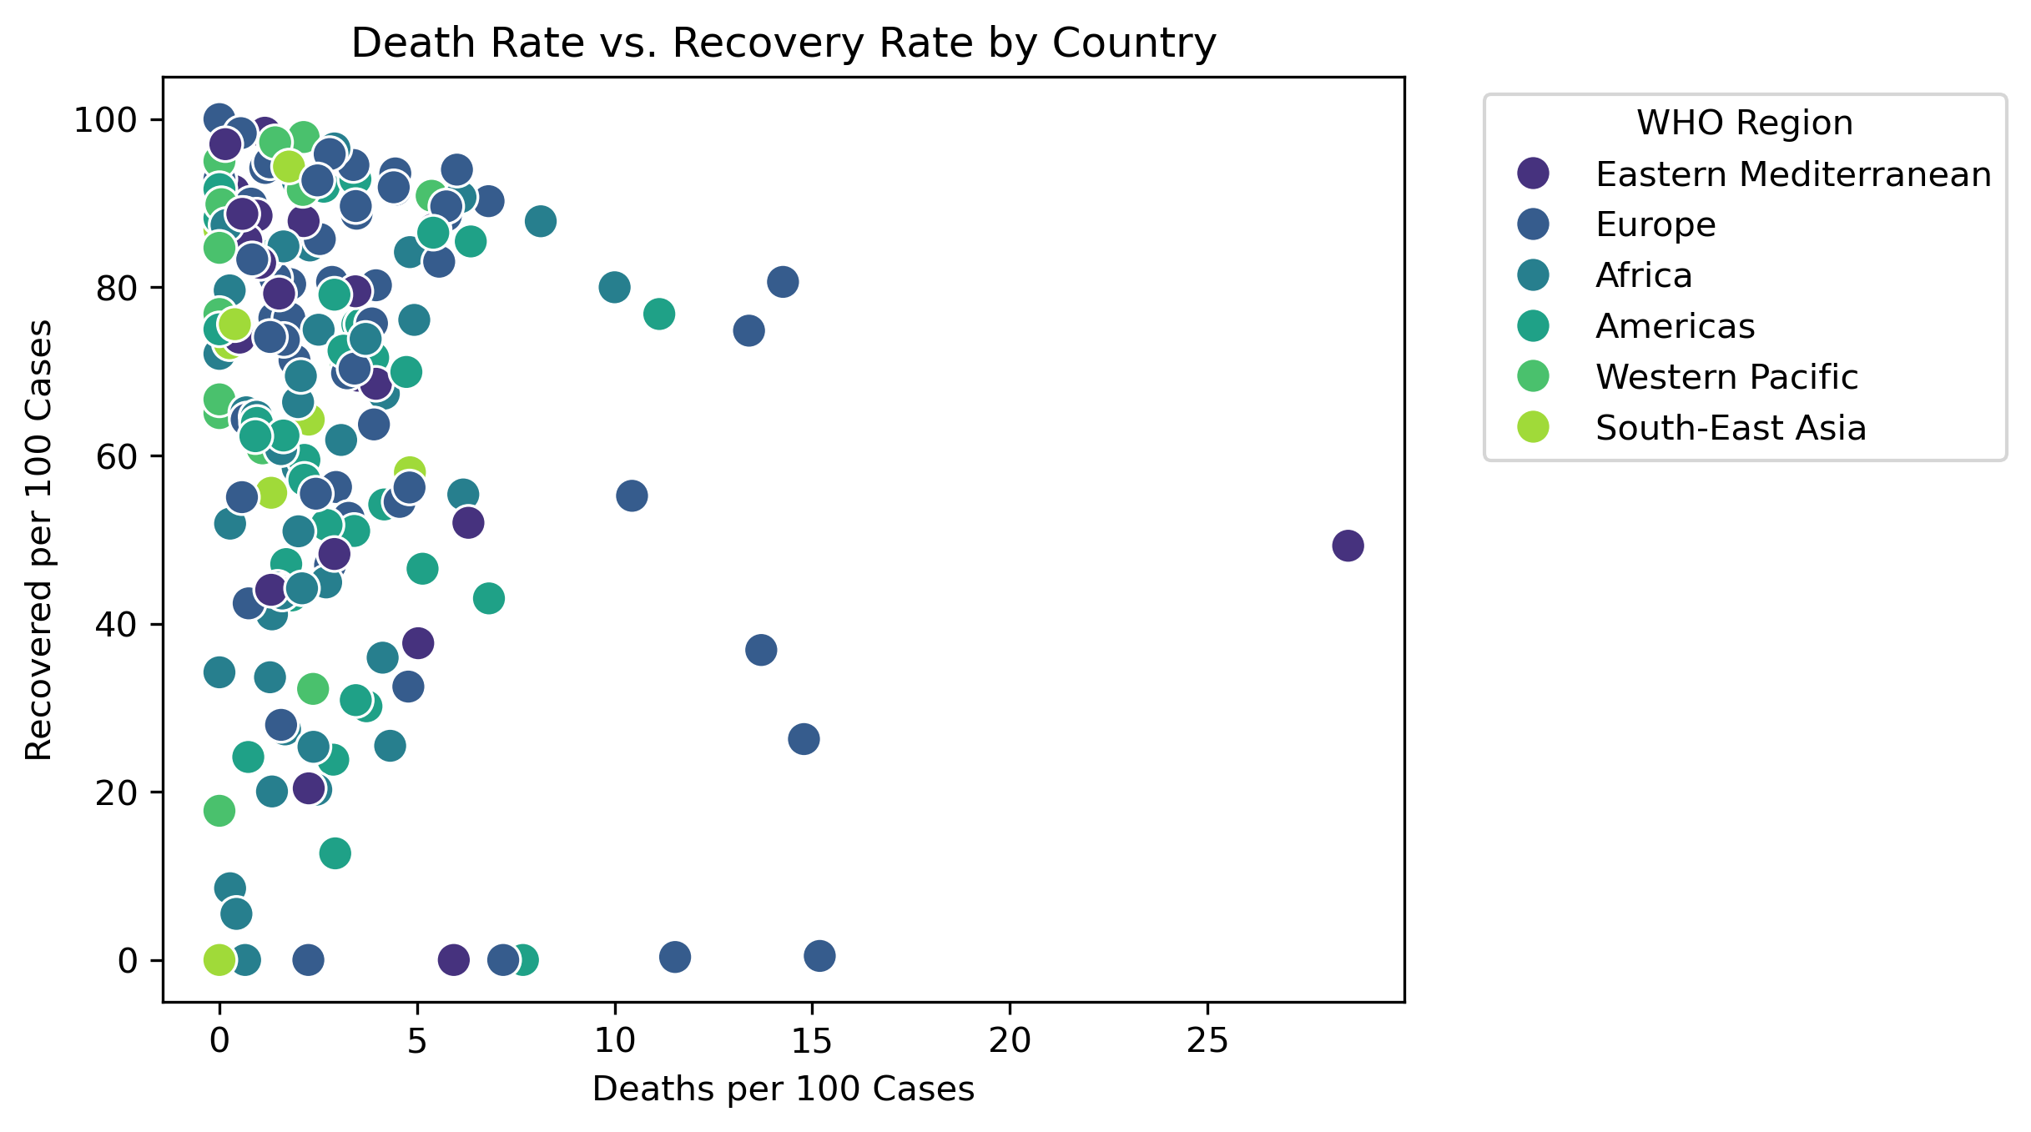
.

Slide 14
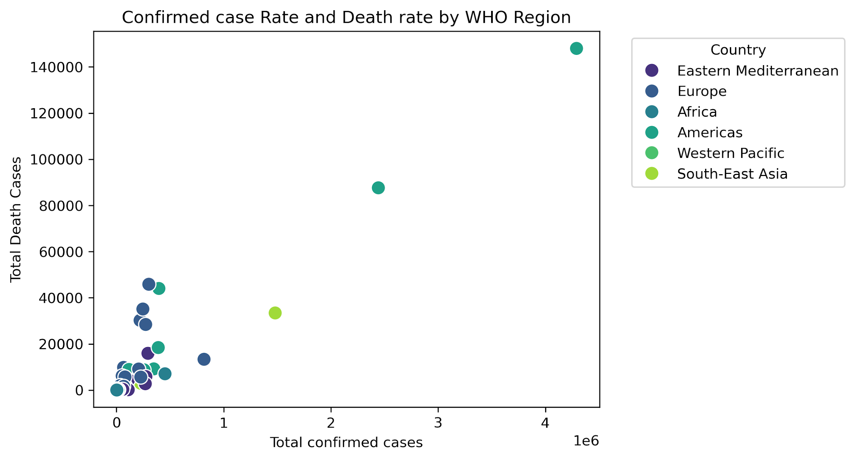
.

Slide 15
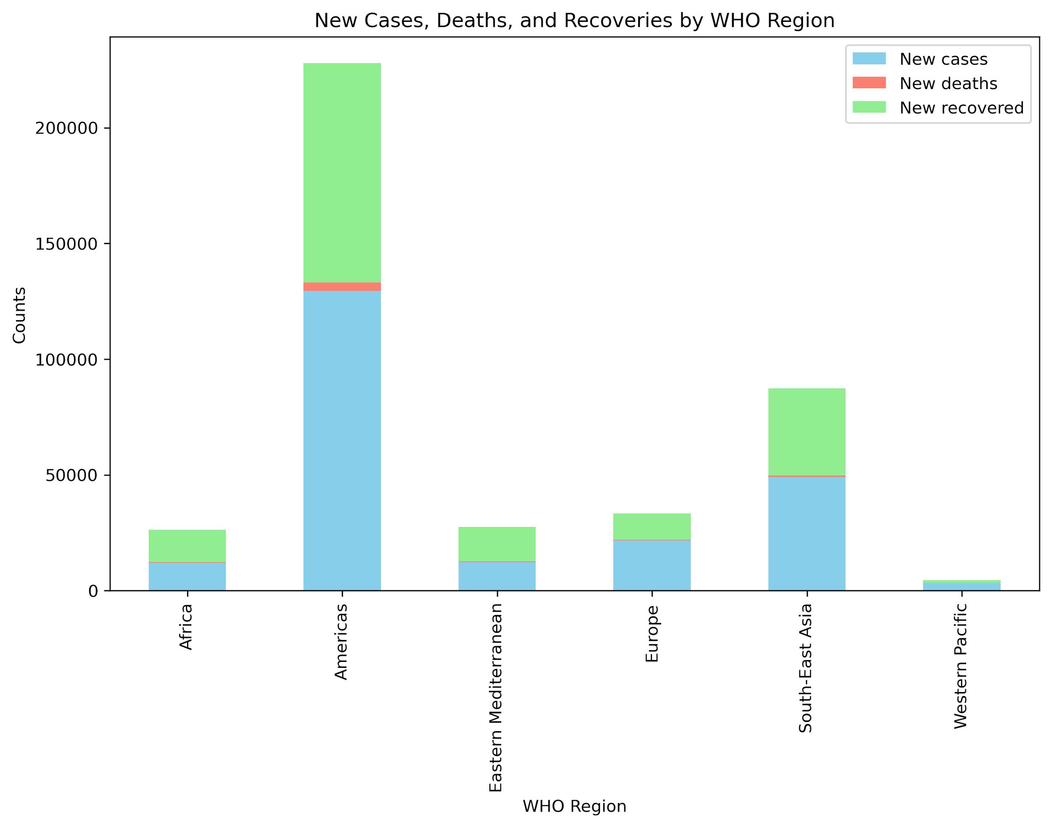
.

Slide 16
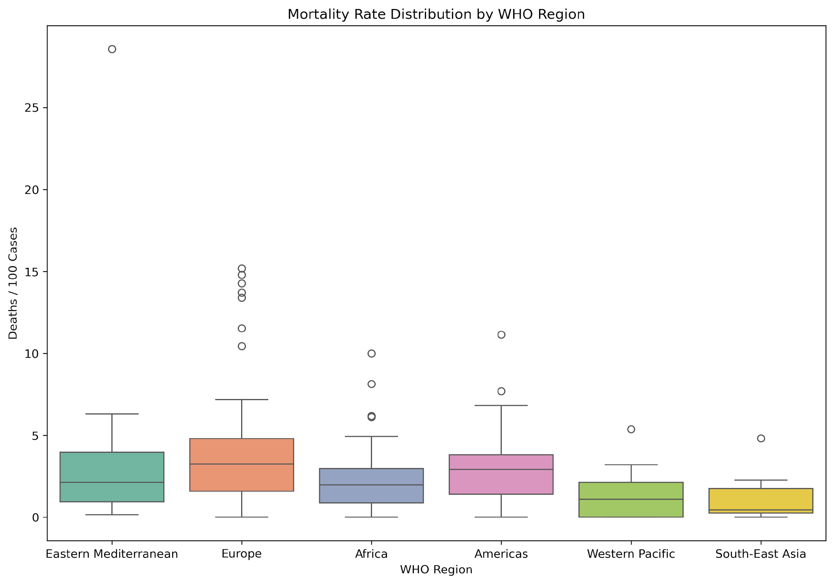
.

Slide 17
Model Development
Time-Series Modeling (Random Forest Regressor)
Goal: Forecast the number of new COVID-19 cases.
Metrics:
Mean Absolute Error (MAE): 138.39.
Mean Squared Error (MSE): 92,052.65.
Root Mean Squared Error (RMSE): 303.40.
R-squared (R²): 0.663 (66.3% of variability explained).

Slide 18
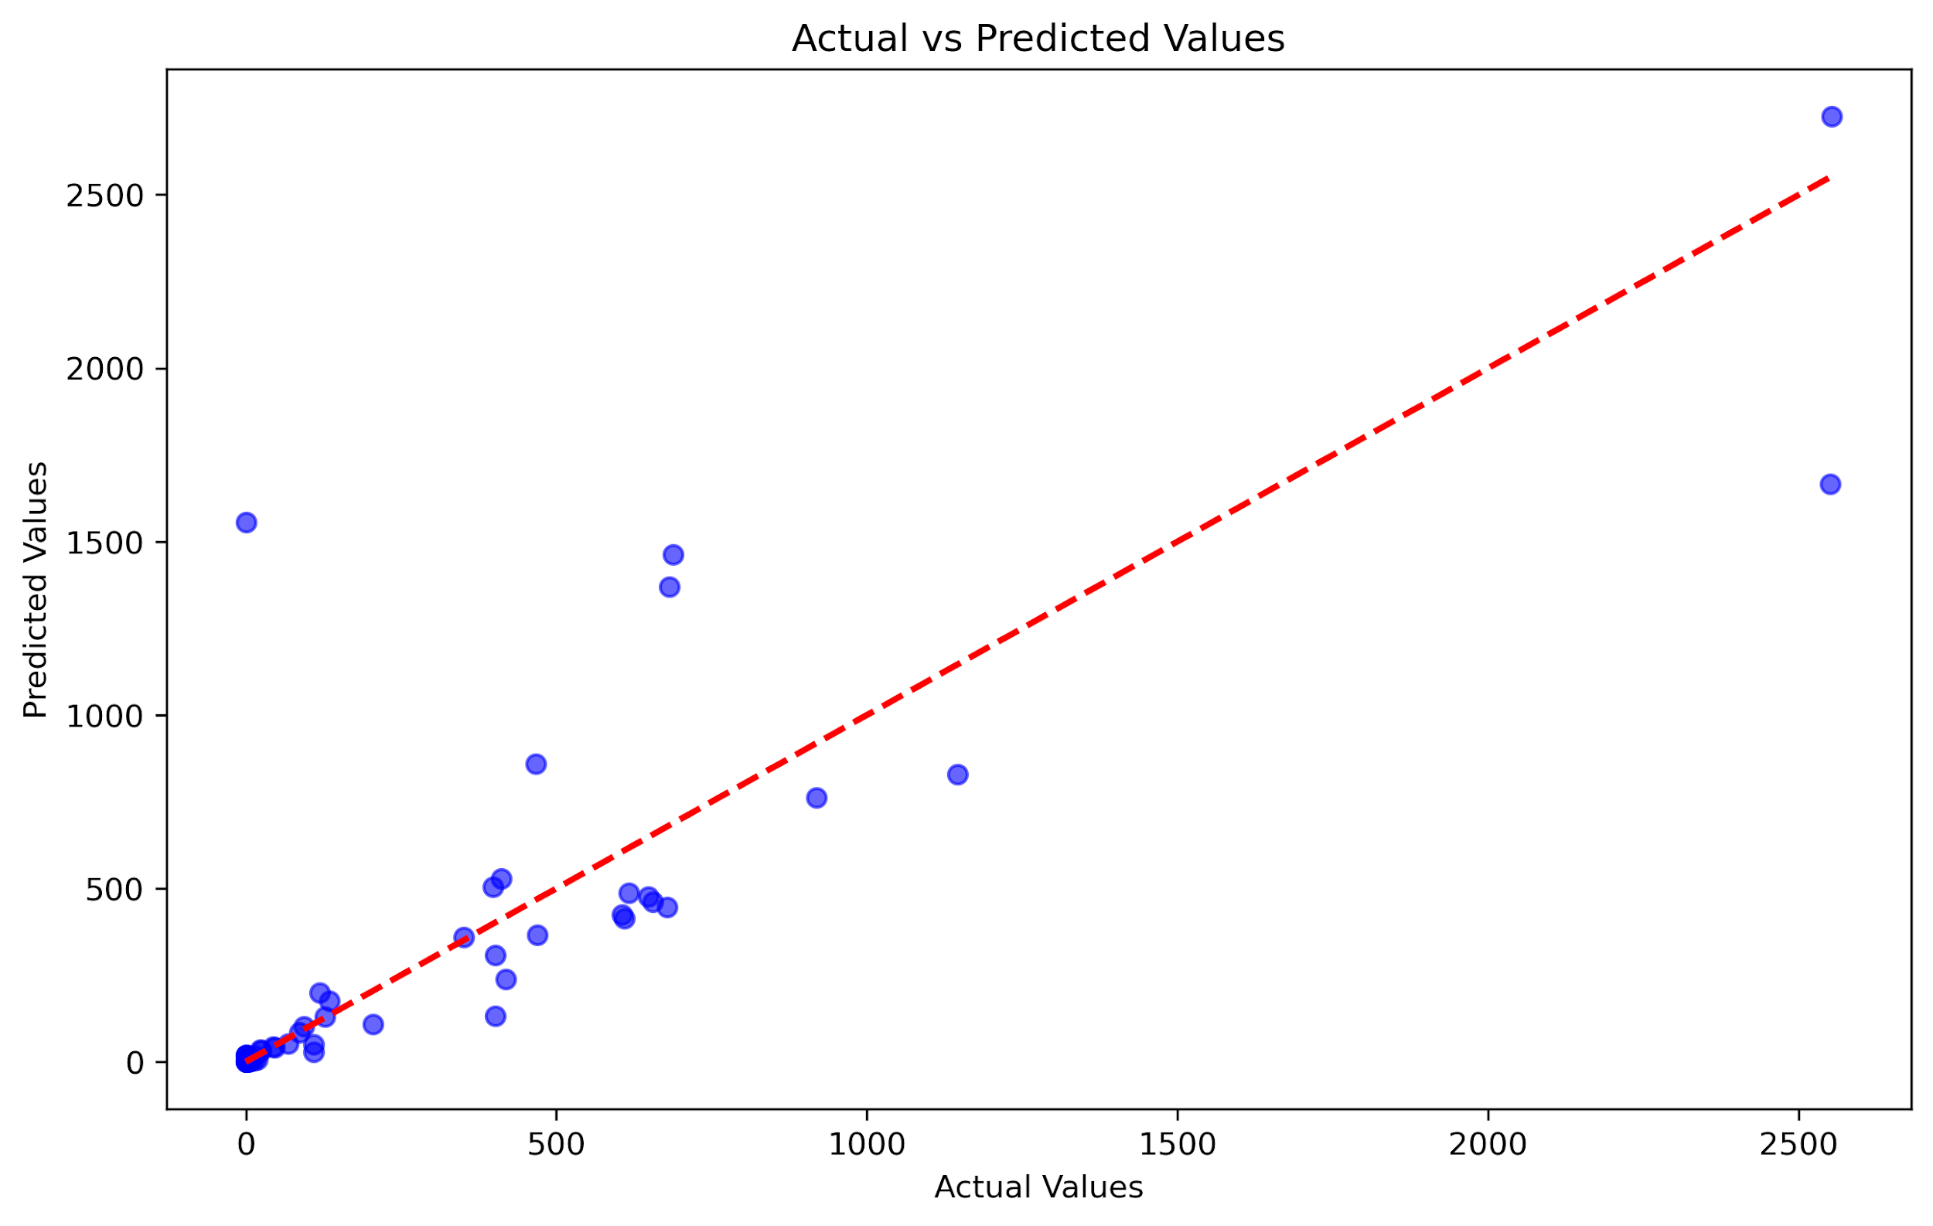
Actual vs Predicted Plot: This scatter plot (shown in the image below) illustrates the relationship between the actual and predicted values. Each point represents a prediction, with the actual value on the x-axis and the predicted value on the y-axis. The red dashed line represents the ideal case where predicted values perfectly match the actual values. Deviations from this line indicate prediction errors, with larger deviations observed in the higher range.

Slide 19
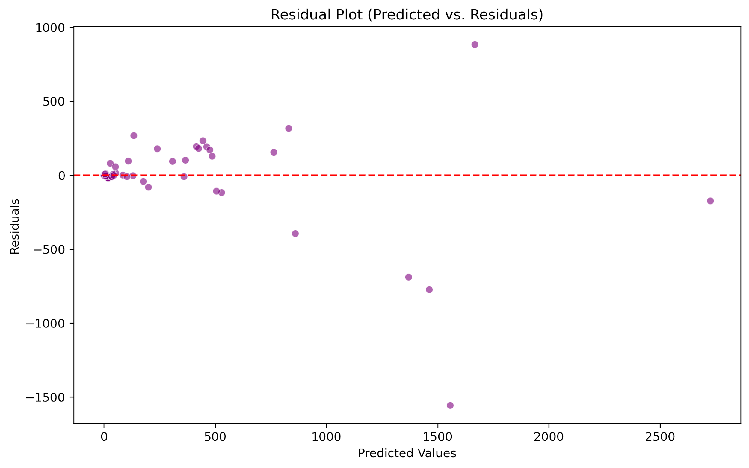
Residual Plot: This scatter plot below shows residuals versus predicted values. Ideally, residuals should be randomly scattered around zero. Here, most points are close to zero, but we see some outliers far from the center, suggesting that the model performs well overall but struggles with a few data points. These outliers might indicate areas for improvement or data points that differ significantly from the rest.

Slide 20
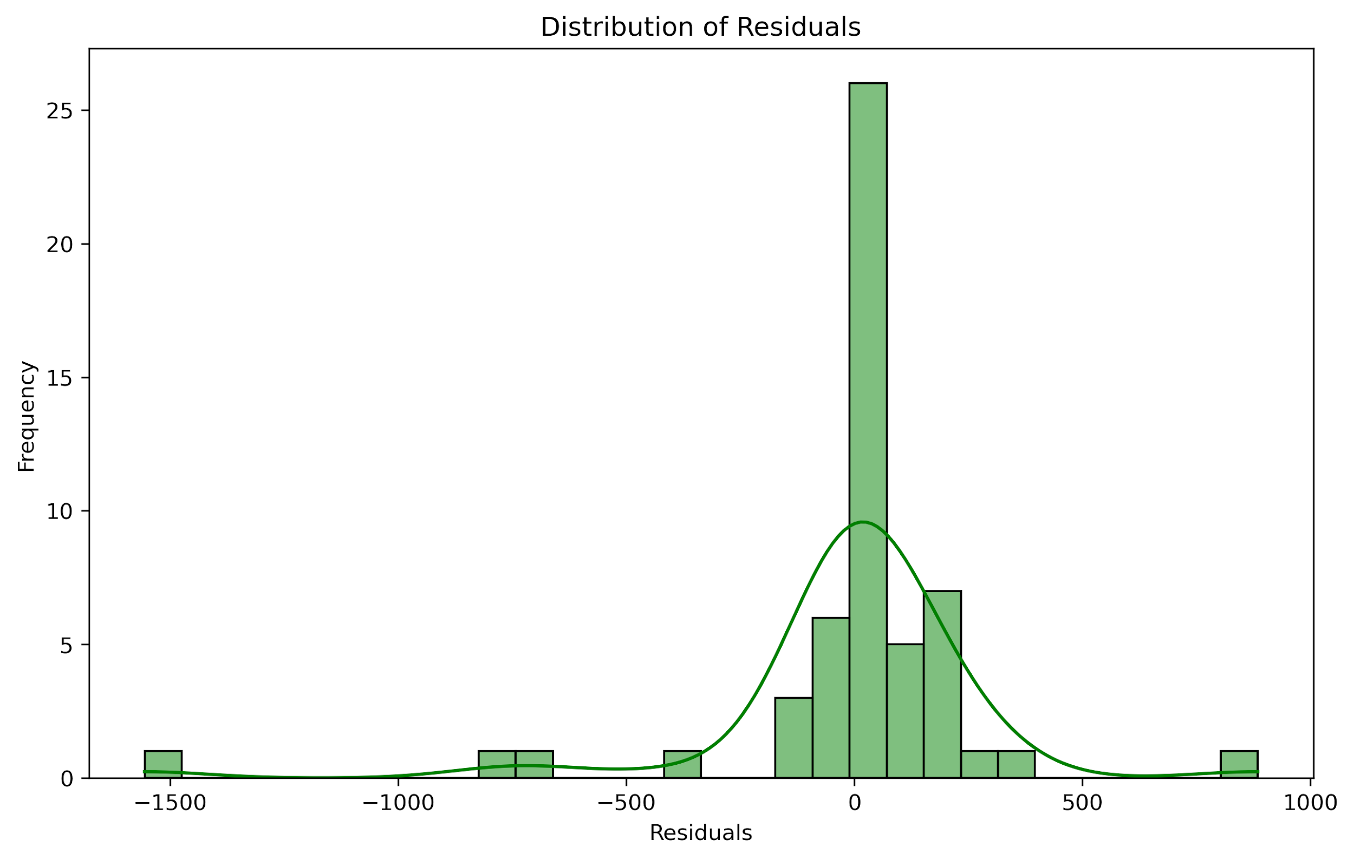
Error Distribution Plot: This histogram below shows the distribution of residuals, or prediction errors, for our model. The concentration of residuals around zero suggests that most predictions are close to actual values. However, the presence of a few extreme values (outliers) indicates occasional large errors.

Slide 21

Results and Insights
Time-Series Model:
Key Features Influencing Predictions:
Explains ~66% of data variability.
Prediction errors: ~138 (MAE),
~303 (RMSE).
Active cases.
confirmed cases.
recovered cases.
Exploratory Data Analysis (EDA): Revealed key trends like case distribution and mortality rates

Slide 22
Conclusion
The models provide actionable insights for:
Predicting case trends.
Improving resource allocation and response strategies.
Areas for improvement:
Addressing outliers in time-series predictions.
Faith Isobo

